Slide 1
Introduction to ADAP
(Advanced Design and Programming)
Dirk Riehle, Univ. Erlangen
ADAP A01
Licensed under CC BY 4.0 International

Slide 2
Course Learning Goals
Understand and apply advanced design and programming concepts
Understand and work with a simple but realistic web application

Slide 3
Skills Required for Course
General requirements
Familiarity with (or willingness to learn) Typescript and an IDE
For an intermediate period
Tolerance for working with a living example

Slide 4
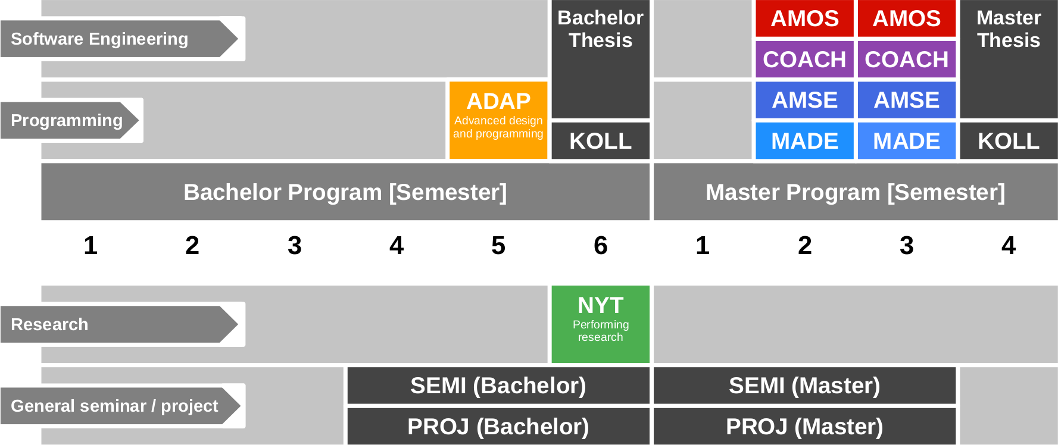
Course Position in Curriculum

Slide 5
Courses and Modules
Module = OSS-ADAP
Lehrveranstaltung = OSS-ADAV-VUE [1] with 4 SWS, 5 ECTS
Lecture part = 2 SWS
Exercise (homework discussion) part = 2 SWS
In the computer science degree program
As seminar (Bachelor, Master)
As a VL + UE (Bachelor, Master) in den Säulen
Theoretische Orientierung
Software-Orientierung
[1] VUE = Lecture + exercise (Vorlesung + Übung)

Slide 6
ADAP-VUE Grading [1]
Semester contributions = 50% of total grade
Lecture content (2 SWS) = 30 / 150 = 20% (of semester contributions)
Graded using [0..10] each class session using class quizzes
Homework = 120 / 150 = 80% (of semester contributions)
Graded using [0..10] using tool and grading rubric
Oral exam = 50% of total grade
If both you and we agree on not having an oral exam, it can be dropped
If you insist on an oral exam, please tell us within two weeks after the last session
[1] See https://oss.cs.fau.de/teaching/course-resources/grading-schemes-and-scales/

Slide 7
Class Quizzes
Each class session starts with a class quiz
A quiz will test your understanding of last session’s topic
A quiz typically has 5 questions and will last 10 minutes
The overall quiz is graded using [0..10] scheme (10 points in total)
A class quiz will open precisely when class starts
The quiz is administered automatically
It is your job to have reliable Internet access etc.
There is no way to make up for a missed quiz
Please sign up on https://myc.uni1.de for the quizzes [1]
[1] GMail, YMail, Proton work, FAU.de works sometimes, GMX.de does not

Slide 8
Homework Grading
All homework submissions will be weighted equally
Each homework will be graded on a [0..10] scale
There will be 12 homework submissions
Miss four or more homework assignments and you fail the course

Slide 9

No Oral or Written Exam [1] [2]
[1] If both you and we don’t want to
[2] You still have to register for the course

Slide 10
Expectation Management (Winter 2024/25)
We skipped ADAP last winter to migrate from Java to Typescript
We did not finish ADAP preparations; hence this instances is experimental
You will not receive any homework feedback during the course
Please take note of these restrictions; we recommend you try next year

Slide 11
Course Language [1]
Class
Lecturer: German
Student: Choice of German or English
Exercise
Instructor: German
Homework: Choice of German or English
[1] See https://oss.cs.fau.de/2012/03/10/english-or-german-deutsch-oder-englisch/

Slide 12
Course Participation (Auditing)
The course is provided publicly, you can always audit it
Auditing will not give you credit points towards a degree

Slide 13
Course Registration / Waitlist
Students must have passed a (trivial) entrance test
We use stratified randomized sampling to select students
Our current student limit for the course is 30 students
Everyone is required to participate in this first class
We will inform you after class if you got off the waitlist

Slide 14
Course vs. Exam Registration [1]
Course registration and exam registration are two separate steps
If you want to receive a grade
You must register through your university’s exam registration system
Your degree program may have split the course into two (VL + UE)
Please check asap that the course is available in your degree program!
Otherwise: No grade
[1] German: Prüfungsanmeldung

Slide 15
Course Organization
Course organization
See https://adap.uni1.de
Course schedule
See Schedule tab on Course organization doc
Project allocation
See Projects tab on Course organization doc

Slide 16
Work Rhythm
Lecture (class)
Review of last week (quiz)
Presentation of this week’s topic
Homework review
Discussion of articles
Discussion of homework
Homework
See Course organization doc
Self-organized

Slide 17
Course Communication
Announcements by email
Through course management system
Questions to teaching team
Please ask your question in the course forum
For private questions, use the teaching team email alias
Non-urgent questions will be answered in class

Slide 18
Thank you! Any questions?
dirk.riehle@fau.de – https://oss.cs.fau.de
dirk@riehle.org – https://dirkriehle.com – @dirkriehle

Slide 19
Legal Notices
License
Licensed under the CC BY 4.0 International license
Copyright
© 2012, 2018, 2024 Dirk Riehle, some rights reserved

